Slide 1
Petfinder: Adoption Speed
Team 13:
Christine Luong
Kathryn Ziccarelli
Tianming Chen

Slide 2
TABLE OF CONTENTS
01
02
03
INTRODUCTION
DATASET OVERVIEW
EXPLORE DATA
04
05
06
CRITIQUE
EXPERIMENTATION
FINAL MODEL & CONCLUSION
Competition Overview
Dataset & Key Features
Explore and preprocess data
Critique Notebooks based on Evaluation Criteria
Model experimentation
Describe final model & reasoning

Slide 3
INTRODUCTION
Overview: PetFinder is Malaysia’s leading animal welfare platform since 2008, with a database of more than 150,000 animals. PetFinder collaborates with different organizations to improve animal welfare.
Mission: To guide shelters around the world on improving their pet profiles’ appeal, so that homes can be found for them; reducing animal suffering and euthanization.
Objective: Develop algorithms to predict the speed at which a pet is adopted, based on the pet’s listing on PetFinder.

Slide 4
DATASET & KEY FEATURES
DEPENDENT VARIABLE
ROWS
01
03
14,993 rows of data
AdoptionSpeed - 0 through 4; Lower number means pet was adopted faster
INDEPENDENT VARIABLES
SOURCE
02
04
Malaysia’s PetFinder.my website
23 variables including age, breed, gender, color, animal type, state

Slide 5
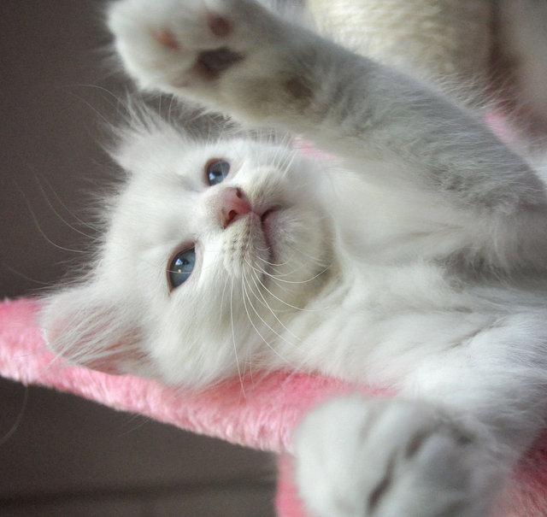
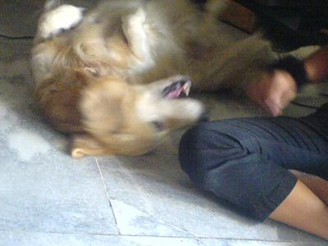
DATASET OVERVIEW
1 - Dog 2 - Cat
Type | Name | Age | Breed1 | Breed2 | Gender | Color1 | Color2
Color3 | Maturity Size | FurLength | Vaccinated | Dewormed | Sterilized | Health | Quantity
Fee | State | RescuerID | VideoAmt | Description | PetID | PhotoAmt | Adoption Speed
2 kittens almost 3 months old to be adopted! :D Free of charge. Can choose either one or take both. Gender still unsure. They already know how to use the litter box. Kitten #1: very playful and likes to play with people. Orange, black & white coloured fur. Kitten #2: curious - always comes to you when you're doing something. White with a few beige coloured fur. Loving owner is needed asap.

Slide 6
PREPROCESS DATA
0 – Doesn’t have a name 1 - Has a name
Type | Name | Age | Breed1 | Breed2 | Gender | Color1 | Color2
Color3 | Maturity Size | FurLength | Vaccinated | Dewormed | Sterilized | Health | Quantity
Fee | State | RescuerID | VideoAmt | Description | PetID | PhotoAmt | Adoption Speed
Type | Name | Age | Breed1 | Breed2 | Gender | Color1 | Color2
Color3 | Maturity Size | FurLength | Vaccinated | Dewormed | Sterilized | Health | Quantity
Fee | State | RescuerID | VideoAmt | Description | PetID | PhotoAmt | Adoption Speed
8480853f516546f6cf33aa88cd76c379,
3082c7125d8fb66f7dd4bff4192c8b14,
fa90fa5b1ee11c86938398b60abc32cb
86e1089a3,
6296e909a,
3422e4906

Slide 7
PREPROCESS DATA
Still have a lot dirty data points:
Type | Name | Age | Breed1 | Breed2
he's very mischevious and playful | he too rescue from BDKL. He would be a great out door companion. | male | around 6 months old | short legs with big paws
hold her | hug her | give her kisses | anything | she won't protest. :)
Drop rows that do not have a 0 - 4 Adoption Speed (Y feature)
Rows with NA values in the Adoption Speed column are removed, and data is now cleaned and ready for training

Slide 8
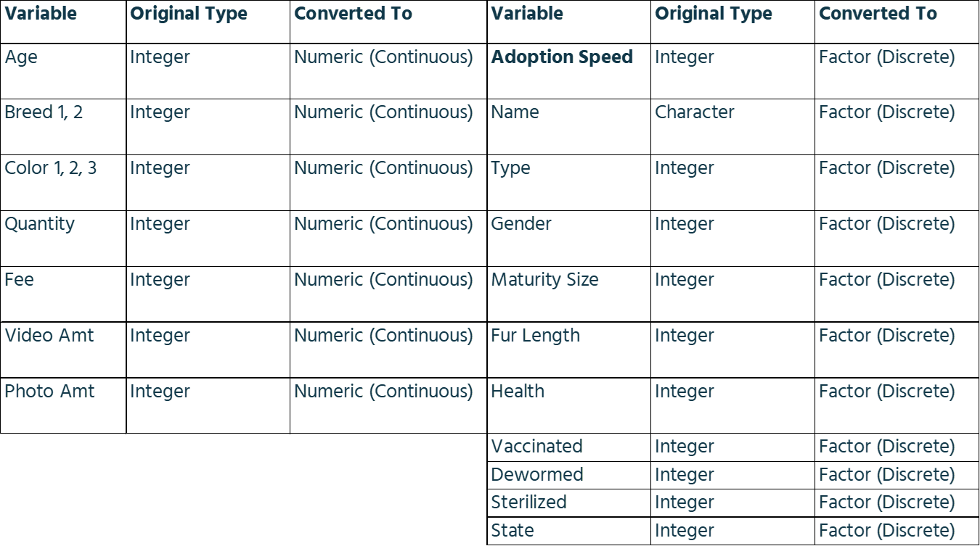
FINAL DATA STRUCTURE

Slide 9
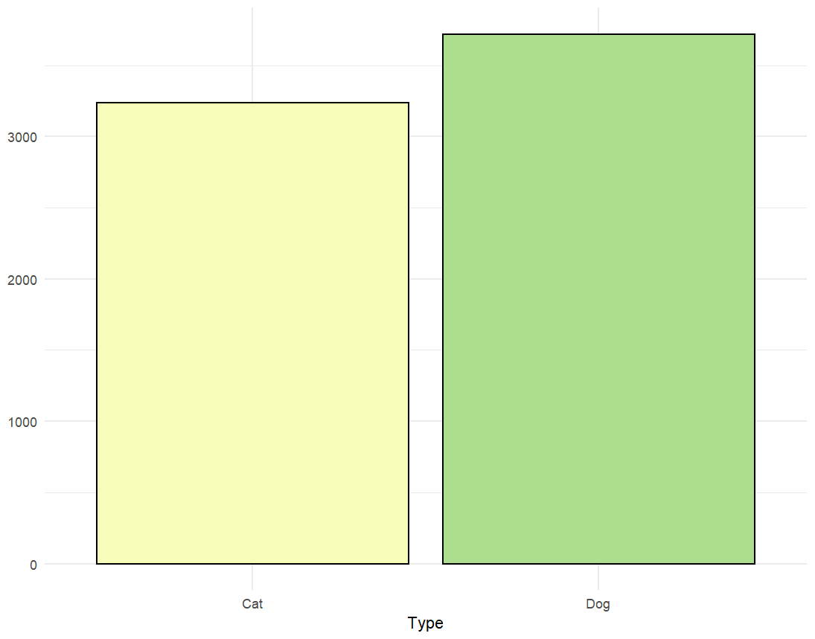
KEY FEATURE PLOTS - TYPE

Slide 10
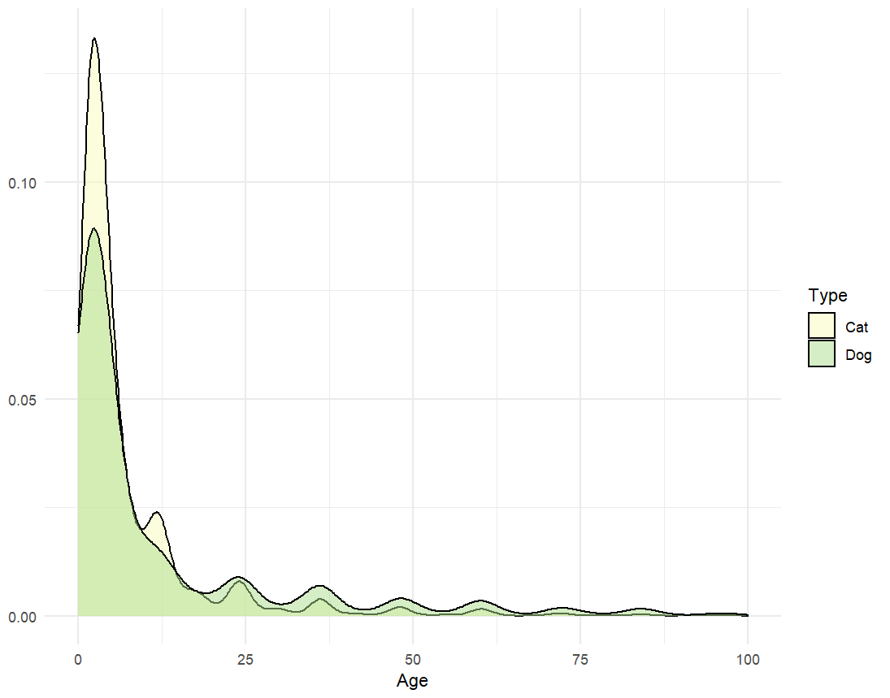
KEY FEATURE PLOTS - AGE

Slide 11
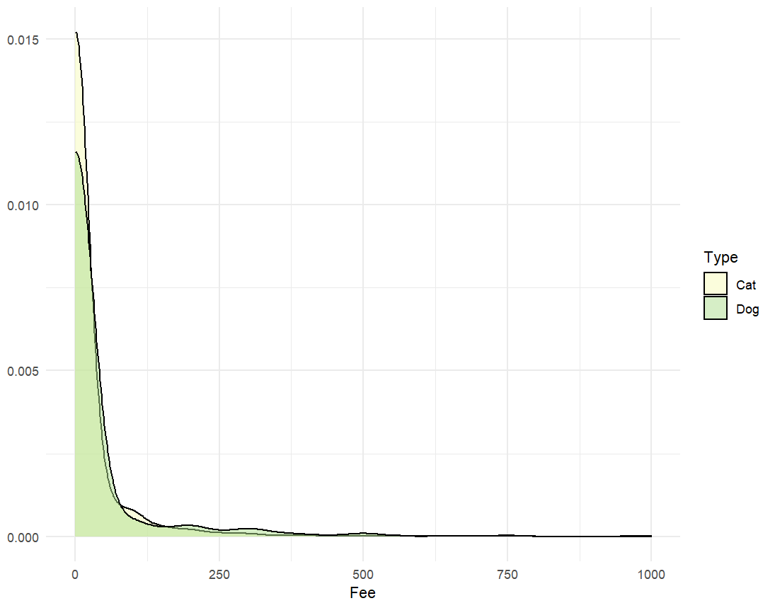
KEY FEATURE PLOTS - FEE

Slide 12
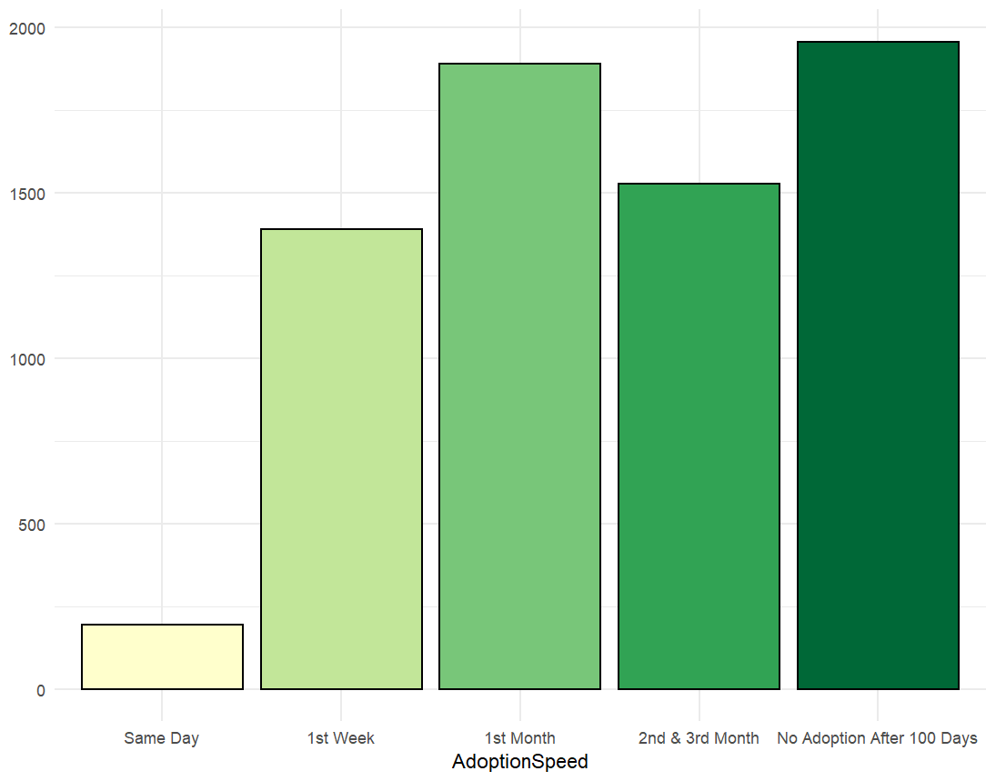
KEY FEATURE PLOTS -
ADOPTION SPEED

Slide 13
EVALUATION CRITERIA
LOAD & PREPARE
TRAIN & TUNE
01
04
Collect & prepare data
Train model and tune parameters
EXPLORE
PREDICT
02
05
Visualize data
Make predictions
SPLIT DATA
EVALUATE MODELS
03
06
Split data into train vs. test
Evaluate models based on MSE for regression or accuracy for classification

Slide 14
CRITIQUE NOTEBOOKS
CSU Team 1
This notebook stopped at step 4 - training a random forest model. The team did a lot of data preprocessing, exploring the data, but did not try different models to see which performed the best
Cory Lowe
This notebook only did steps 1 and 2 - loading data, preparing data, and exploring data. No model was trained, and no predictions were made. A lot of notebooks were similar to this where there was only descriptive statistics but no model or predictions made
Ivette Cardona
This notebook trained a linear regression model, but resulted in errors. This is a classification problem because the dependent variable is not continuous

